Slide 1

KGiSL INSTITUTE OF TECHNOLOGY
COIMBATORE
DEPARTMENT OF computer science & engineering
Project phase review # 03
WOMEN SAFETY APP FOR IMPROVED PERSONAL SECURITY
Team Members:
711719104055 NAVEEN KUMAR S
711719104057 NEWTTON HABAKUK S 711719104061 NIVETHITHA S
711719104063 POOJA B
Under the guidance of :
Ms. Aruna T N , Asst. Professor,CSE.

Slide 2

agenda
Abstract
Existing System
Proposed System
References
Timeline

Slide 3
ABSTRACT
The women safety app is designed to improve personal security by providing a range of features, including GPS tracking, hidden camera detection, emergency SOS, panic button, and other extra features. The app aims to empower women and provide them with an added layer of protection, allowing them to feel safe and secure. With its user-friendly interface and multiple features, the app can help women in distress situations, making them feel more confident and secure.

Slide 4
EXISTING SYSTEM
Currently women safety app is enabled with emergency SOS and tracking nearby police stations involves the use of mobile applications that enable users to alert authorities in case of an emergency situation.
This app has limitations. For instance, the app may not be able to accurately track the user's location in areas with poor network connectivity or GPS signals
DRAWBACKS
Women news is not available in previous model of women safety app.
The usage of the app can only be accessed within the app.
There is no feature for detecting hidden camera.

Slide 5
Literature survey
SNo | Published Year | Paper Title | Authors | Technology
1 | 2021 | Android app for women safety | K.Srinivas , T.Susmitha | Application development
2 | 2020 | Efficient tracking for women safety and security | S. Vahini | Application development
3 | 2019 | Tracking and Security system for Women using GPS | Tristan Rajendra Shimpi | Application development
4 | 2018 | Women safety device using ARM | Sharma S | Application development
5 | 2018 | Women security system by using GSM | RashmiDeodhe | Application development

Slide 6
PROPOSED SYSTEM
Developing a Mobile Application for ensuring women safety using features such as GPS tracking, Detecting hidden camera, Women NEWS, sending distress signal to guardian and control room for emergency situation, panic button to distract the person suppose in any conflict using siren sound, and some extra features Concerning women safety.
ADVANTAGES
The model will allow user to trigger a siren, which can Deviate the attacker and attract the attention of nearby people for help.
Women news is available for knowing daily news about women problems.
Detecting the hidden camera using magnetometer and Manual instruction and tips for detecting hidden camera in several places.

Slide 7
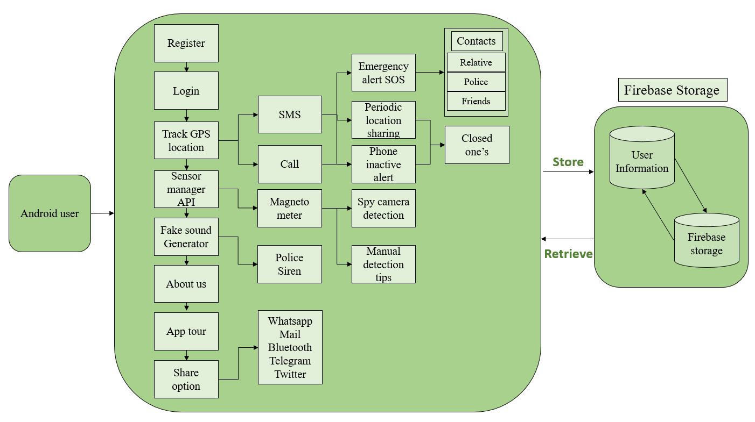
Architectural Diagram

Slide 8
Modules Split up
Module 1 : UI design and User Authentication Check
Module 2 : Emergency Alert using button click and sending notification with exact location
Module 3 : Siren Alert for distraction and women’s news on daily basis
Module 4 :Spy camera Detection and Manual tip for finding Hidden camera

Slide 9
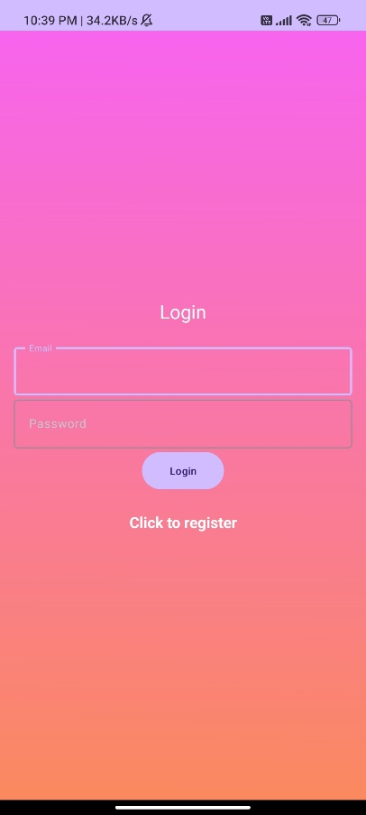

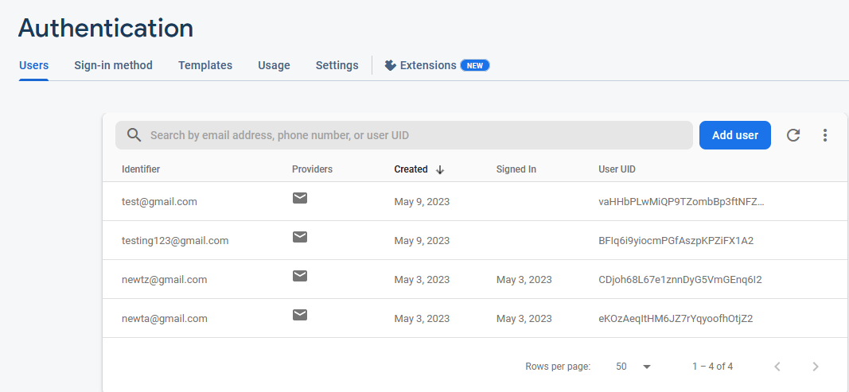
Module 1 – UI design and User Authentication Check

Slide 10
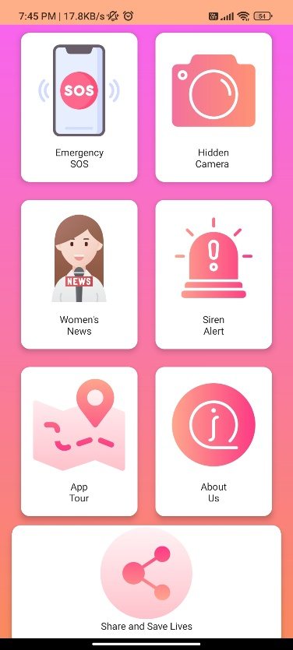
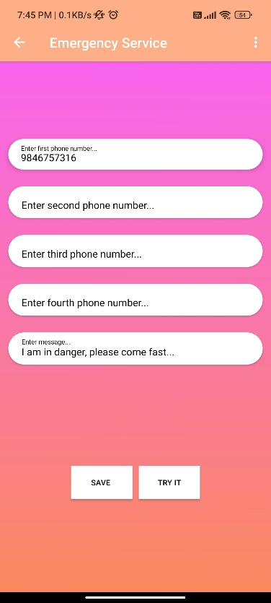
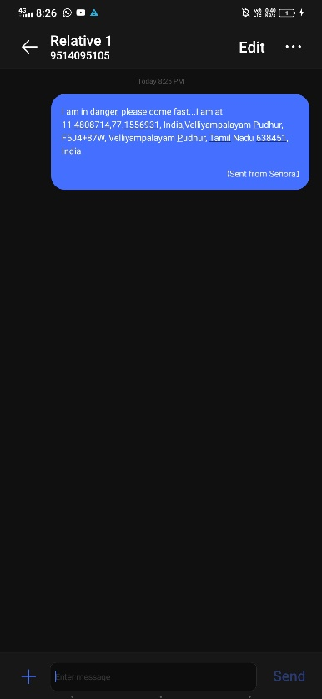
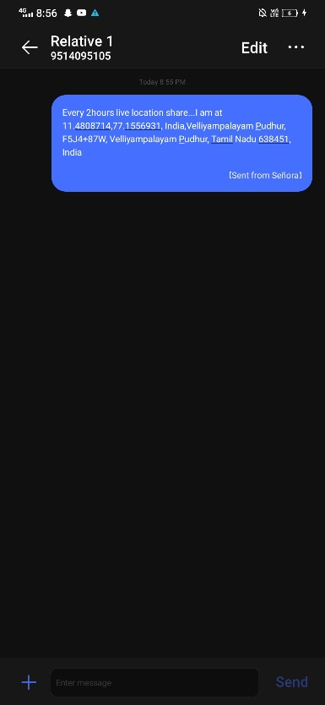
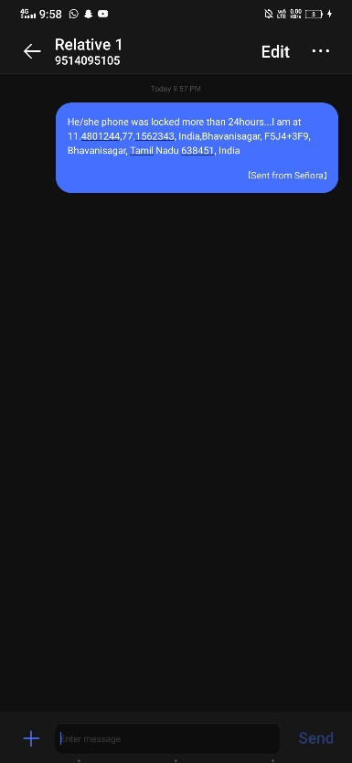
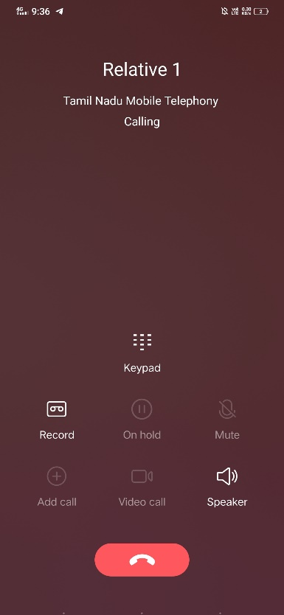
Module 2 – Emergency Alert using button click and sending notification with exact location

Slide 11
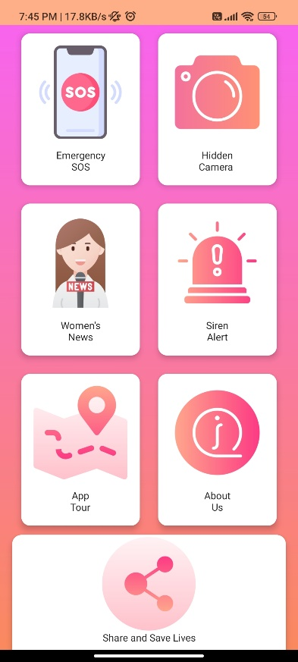


Module 3 – Siren Alert for distraction and women’s news on daily basis

Slide 12

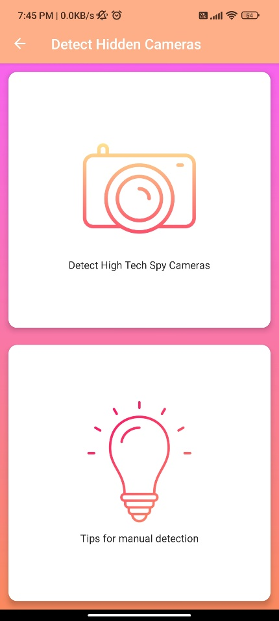
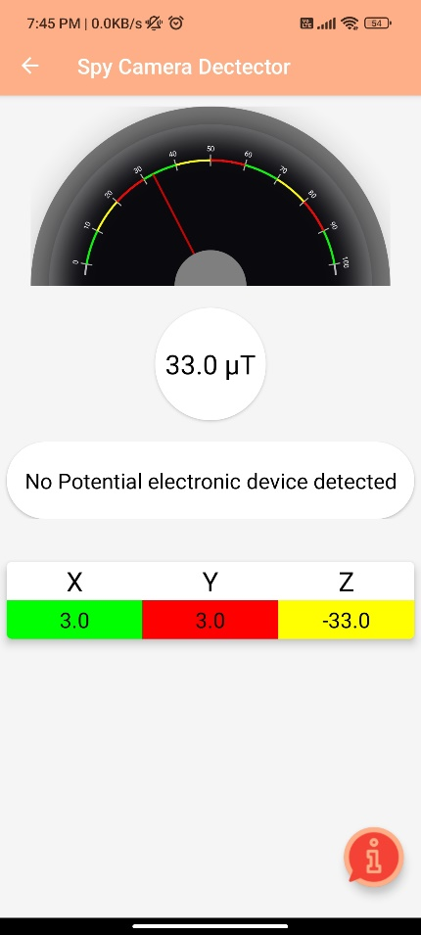
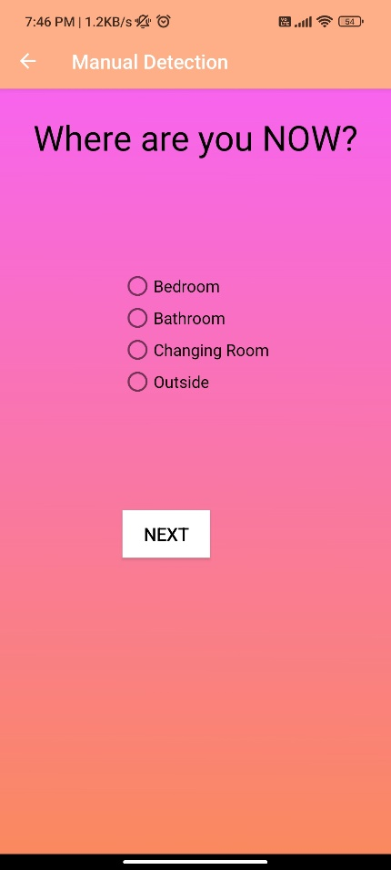

Module 4 – Spy camera Detection and Manual tip for finding Hidden camera

Slide 13
CONCLUSION
A women safety app can be an effective solution for reducing incidents of harassment and violence against women. By providing emergency features, safety resources and tips, community support, and additional features, the app can empower women and provide them with the necessary tools to stay safe. In addition to providing immediate support and assistance during emergencies, a women safety app can also create a sense of community among women, allowing them to share their experiences and provide support to one another.

Slide 14
FUTURE ENHANCEMENTS
The future scope for a women safety app for improved personal security is vast, and there are numerous possibilities for its development. Here are some potential areas for future enhancement:
Artificial Intelligence (AI) integration: One possible future enhancement could be the integration of AI, which can help the app learn the user's behavior, preferences, and patterns to provide personalized safety recommendations and alerts.
Wearable Technology Integration: Another possible future enhancement is the integration of wearable technology like smartwatches or fitness bands to provide an additional layer of safety and monitoring.
Voice-activated Features: Voice-activated features could be another potential enhancement, which will allow users to activate safety features using their voice commands.
Machine Learning: Machine learning can be applied to analyze and identify patterns in data collected by the app, which can be used to provide more personalized safety recommendations and alerts.

Slide 15
REFERENCE
[1] S. Vahini, N. Vijaykumar, Efficient tracking for women safety and security using IoT, International Journal of Advanced Research in Computer Science, Volume 8, No,.9, November-December 2018.
[2] S. Sangeetha, P. Radhika, "Application for Women Safety", IOSR Journal of Computer Engineering (IOSRJCE), Volume 17, Issue 3, Ver. IV (May – Jun. 2016), PP01-04.
[3] TruptiRajendraShimpi, “Tracking and Security System for Women’s using GPS & GSM", International Research Journal of Engineering and Technology (IRJET),Volume: 04 Issue:07 | July-2017.
[4] RashmiDeodhe, “Woman Security System By UsingGps & Gsm”, International journal for engineering applications and Technology, ISSN:2321-8134.
[5] Sharma, S., Ayaz, F., Sharma, R., Jain, D., & Student, B. E. (2019). IoT Based Women Safety Device using ARM7.

Slide 16
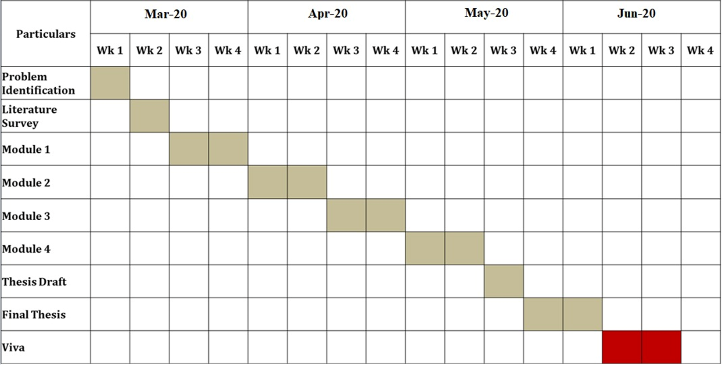
TIMELINE
Feb-23
Mar-23
Apr-23
May-23

Slide 17
THANK YOU

